Slide 1
exceed PROFIT MARGIN with TICKET PRICES
A phase 1 plan on how to exceed current profit margin including new chair lift

Slide 2
THE PROBLEM
Black Mountain Resort (BMR) installed new chairlift which increased operating costs by $1.54 million.
Goal is to maintain or exceed 9.2% profit margin this upcoming ski season.

Slide 3
solution
Increase weekend ticket prices from $81.00 to $88.00, an increase of almost 9%.
The current ticket price is too low compared to the market value.

Slide 4
The Science behind the results
Compared actionable factors such as average ticket prices and days open throughout the year for all 330 resorts in the United States
Did not include uncontrollable factors such as resort location and elevation
Model had an accuracy rate of over 91%
Complete Project Report and Coding Notebook was sent to your inbox

Slide 5
Now what?
Phase 1: Increase adult weekend ticket prices to $88.00
Phase 2: Green light for further investigation to build a comprehensive model of how to exceed 9.2% profit margin
Phase 3: Apply comprehensive model to the business strategy

Slide 6
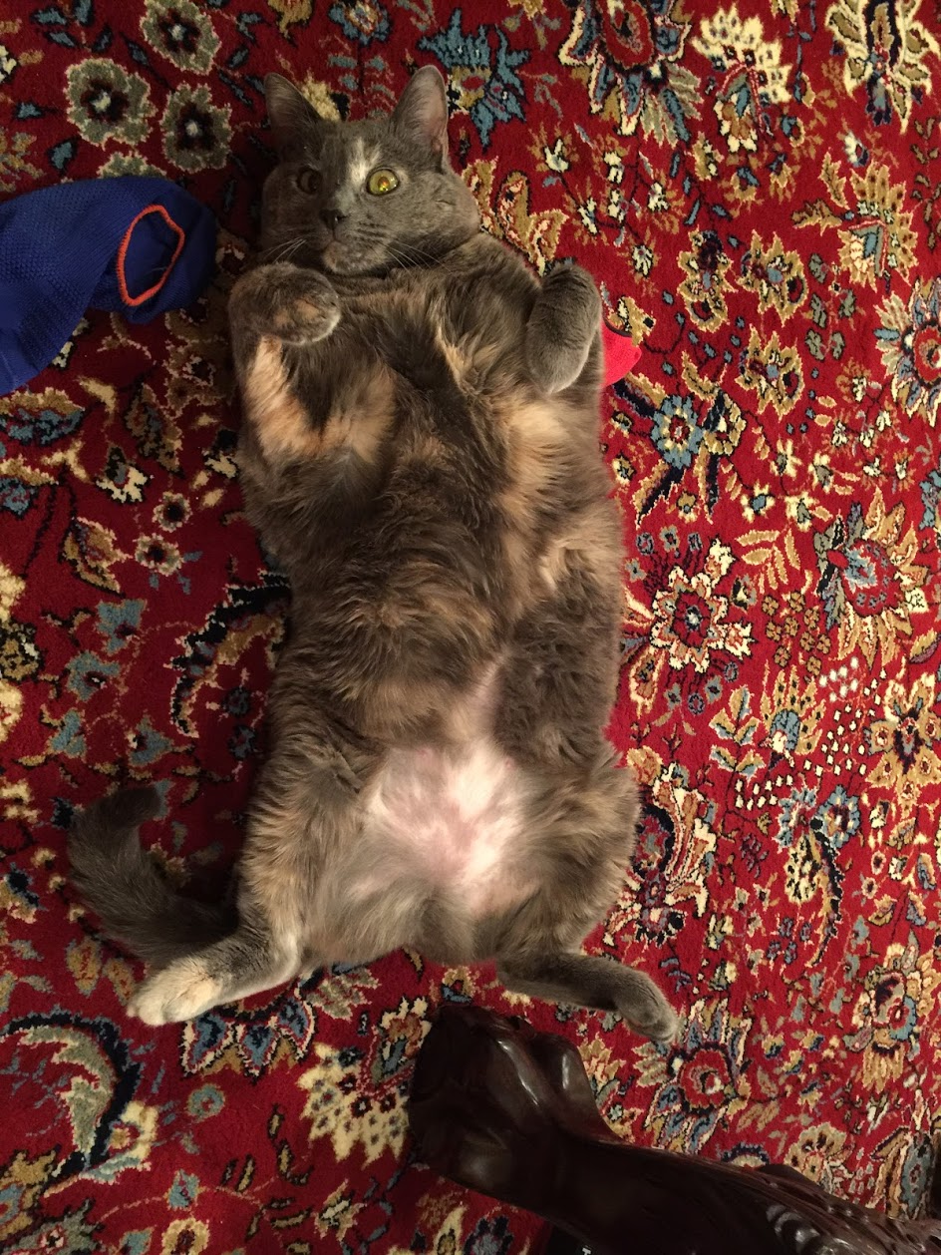
Questions?

